Slide 1
RAJESWARI VEDACHALAM GOVERNMENT ART COLLEGE,
CHENGALPATTU.
III - BSC COMPUTR SCIENCE
TEAM MEMBERS NAME
SANJAY R (LEADER)
SANTHOSH K
LOKESHWAR S S
AJAYSAGAYAM V

Slide 2
Predicting Personal Loan Approval
Using
Machine Learning

Slide 3
Problem Definition
Specify the business problem.
Business requirements for a machine learning model to accurately predict loan approval based on applicant information.
Literature Survey, Now a days digitalizing in banking sector, so people want to apply loan through the internet.
Social or Business Impact.

Slide 4
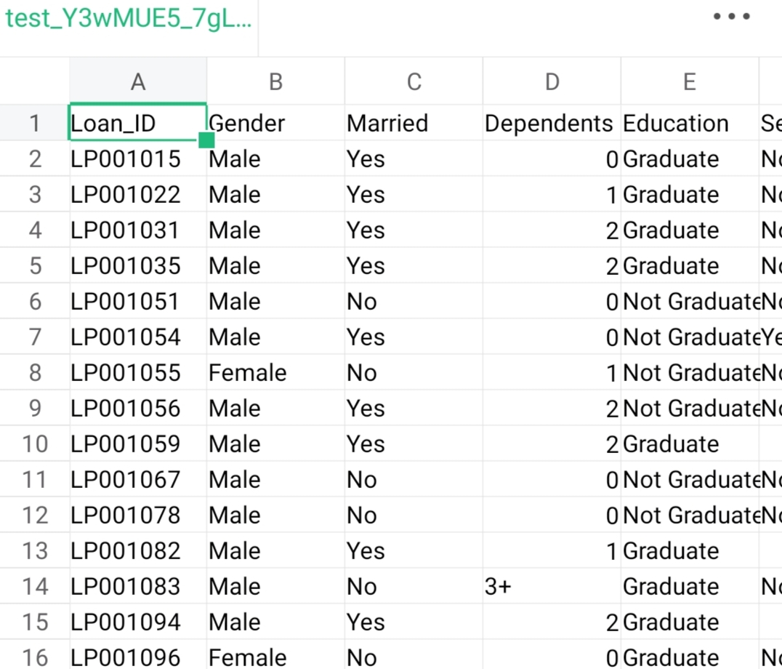
Data Collection & Preparation
Collect the dataset from open sources. Ex: kaggle.com
Importing the necessary libraries
Read the Dataset
Data Preparation : Handling the missing values, Categorical Values, Imbalance Data.

Slide 5
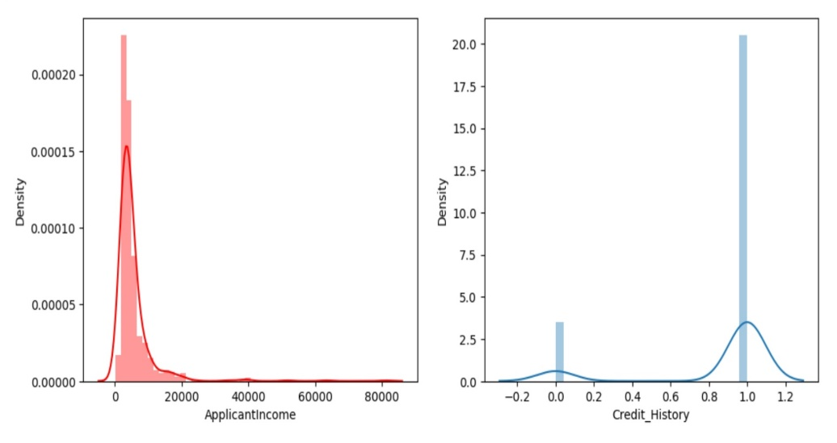
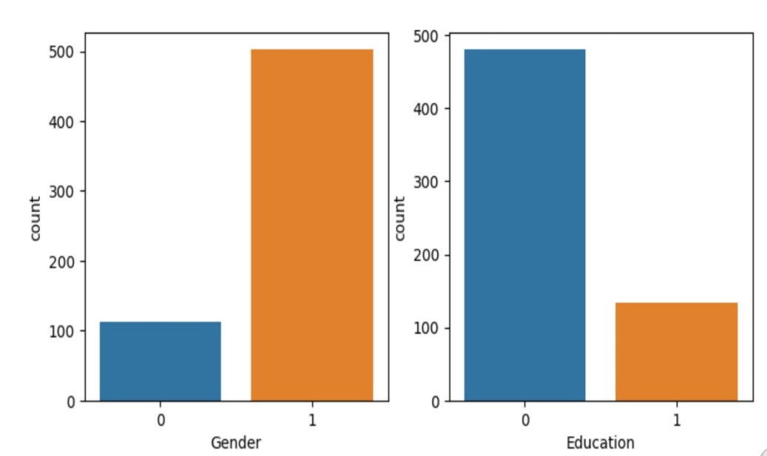
Exploratory Data Analysis
Descriptive analysis is to study the basic features of data with the statistical process.
Visual analysis is the process of using visual representations
Univariate analysis, Bivariate analysis, Multivariate analysis to represent in graph.
Scaling the data and Splitting data into train and test

Slide 6
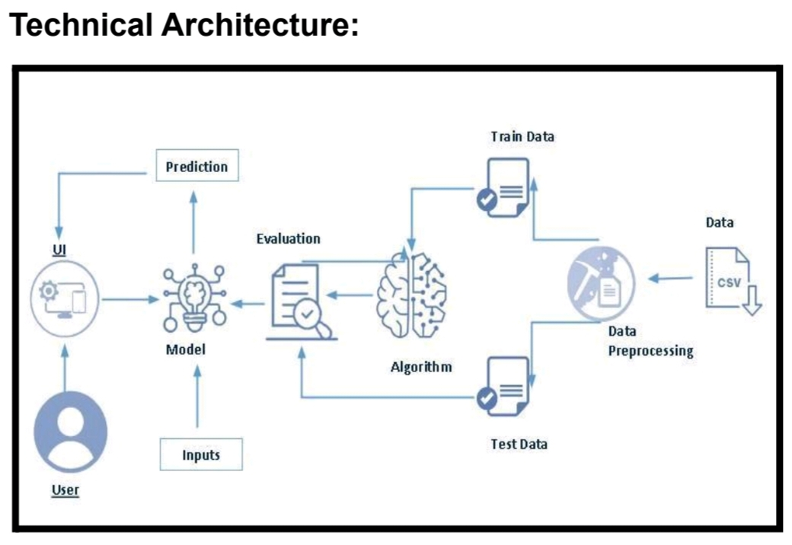

Slide 7
Model Building
Training the model in multiple algorithms to build the model.
Decision tree, Random forest, KNN, Xgboost models are created and train and test data are passed as the parameters.
Building and training an Artificial Neural Network (ANN) using the Keras library
Testing the mode
Accuracy percentage(before tuning): 0.7898840463814475

Slide 8
Performance Testing & Hyperparameter Tuning
Testing model with multiple evaluation metrics
Compare the model
Comparing model accuracy before & after applyinghyperparameter tuning
Accuracy percentage(after tuning): 0.8444580839854738

Slide 9
Model Deployment
Saving the best model after comparing its performance
Integrate with Web Framework : Building a web application that is integrated to the model
Building HTML pages and Python codes and import libraries then finally run the web application into our system.

